Slide 1
Smart Home Management
TEAM MEMBERS:
99210041832 A.V.MOHAN RAO
99210041971 A.PRAVEEN KUMAR
99210042107 M.BHARATH KUMAR
9921004937 N.SAI SRINADH

Slide 2
INTRODUCTION
Smart home technology refers to devices and appliances in your house that can be controlled remotely using an app or voice commands. These devices connect to the internet, allowing you to manage them from anywhere.

Slide 3
FEATURES:
Convenience: Imagine turning on lights, adjusting the thermostat, or locking doors from your phone. Smart home tech makes daily tasks easier.
Security: Smart locks, security cameras, and motion sensors can give you peace of mind and allow you to monitor your home remotely.
Energy Efficiency: Smart thermostats can learn your routines and adjust heating and cooling automatically, saving on energy bills. You can also control lights and appliances remotely to avoid waste.
Customization: Routines can be set to automate tasks based on your preferences. Lights can come on at sunset, the coffee maker can start brewing before you wake up, and so on.

Slide 4
Components:
Smart Home Devices:
Lights (LEDs)
Temperature Sensor
Fog Node (Simulated with Raspberry Pi):
Microcontroller (Arduino Uno)
Cloud Server (Simulated):
Can be another part of your Tinkercad simulation (optional)
Software:
Tinkercad Circuits
Tinkercad Blockly

Slide 5
WORKING PRINCIPLE
The Devices:
Smart Appliances: These include lights, thermostats, locks, cameras, doorbells, speakers, thermostats, refrigerators, and more. Each device has built-in sensors and processors.
Sensors: These detect things like temperature, motion, light, or smoke. Sensors collect data about the environment.
Actuators: These are the physical components that perform actions based on instructions. Smart bulbs turning on/off or locks engaging/disengaging are examples.

Slide 6
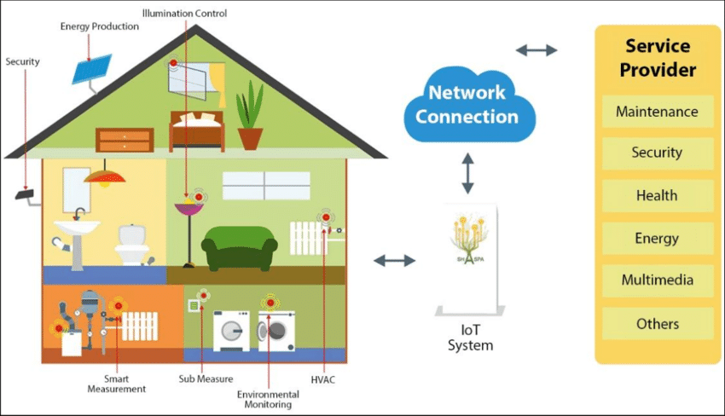

Slide 7
COMMUNICATION
Connectivity: Devices connect to a central hub using various protocols like Wi-Fi, Bluetooth, Zigbee, or Z-Wave.
Data Flow: Sensors send data about the environment to the hub. The hub then communicates with actuators to control devices or sends data to the cloud (optional) for further processing or storage

Slide 8
Central Hub and App:
Hub: This is the brain of the system, coordinating communication between devices and the user. You might have a physical hub or use a smartphone app as the central control.
App: This allows you to interact with your smart home system. You can set schedules, receive alerts, monitor devices, and control them remotely.

Slide 9
CONCLUSION
Overall, smart home management offers a compelling vision for the future of living. As technology advances and costs become more affordable, smart homes have the potential to become the norm, transforming how we interact with our living spaces.

